Slide 1
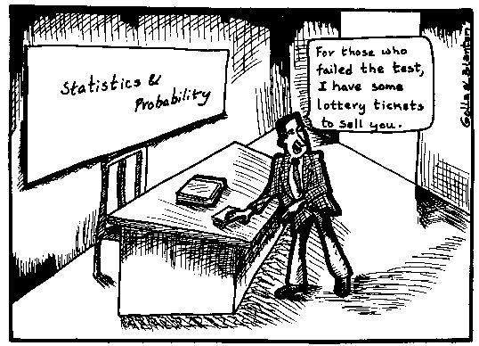
Introduction to Statistics and Probability

Slide 2
STATISTICS
It is the science of collecting, organizing, analyzing and interpreting data.
There are two types of Statistics:
Inferential Statistics : It is about using sample data from a dataset and making inferences and conclusions using probability theory.
Descriptive Statistics: It is used to summarize and represent the data in an accurate way using charts, tables and graphs.
For example, you might stand in a mall and ask a sample of 100 people if they like shopping at Sears. You could make a bar chart of yes or no answers (that would be descriptive statistics) or you could use your research (and inferential statistics) to reason that around 75%-80% of population.

Slide 3
DESCRIPTIVE STATISTICS
The following measures are used to represent the data set :
Descriptive Statistics
Measure of Position
Measure of Spread
Measure of Shape

Slide 4
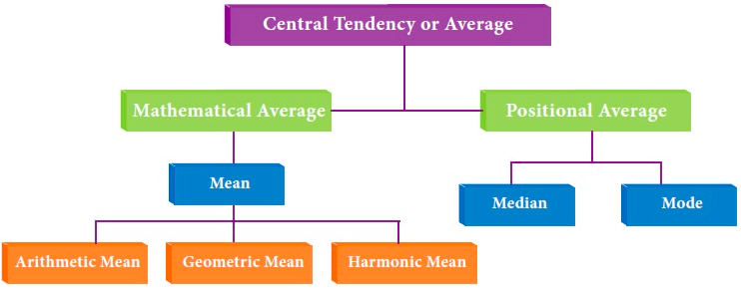
MEASURE OF POSITION
Also known as measure of Central Tendency.
A measure of central tendency is a single value that attempts to describe a set of data by identifying the central position within that set of data.
There are three measures of central tendencies: Mean, Median and Mode.

Slide 5


Mean: It is a point where mass of distribution of data balances.
Median: It is a point that divides the data into two equal halves while being less susceptible to outliers compare to mean.
For ungrouped data: middle data point of an ordered data set.
For grouped data :
Where,
L = lower limit of median class
n = number of observations
cf = cumulative frequency of class preceding the median class
f = frequency of median class
w = class size

Slide 6
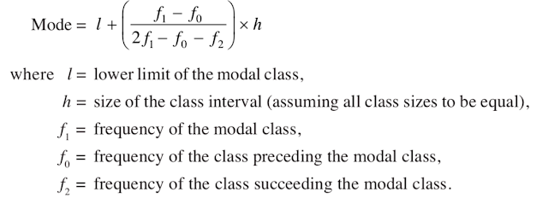
Mode: It refers to the data item that occurs most frequently in a given data set.
Mode for ungrouped data: Most frequent observation in the data.
Mode for grouped data:

Slide 7

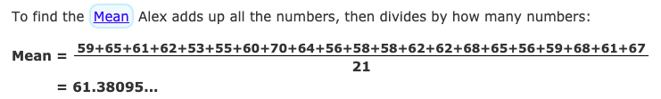
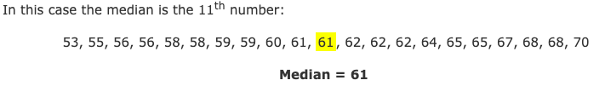

Example for ungrouped data:
Question:

Slide 8
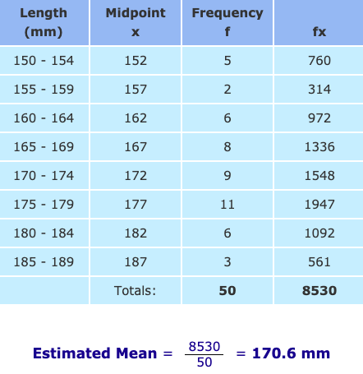
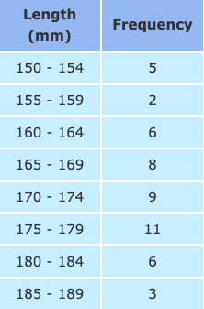
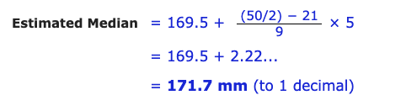
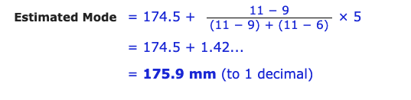
Example for grouped data:

Slide 9
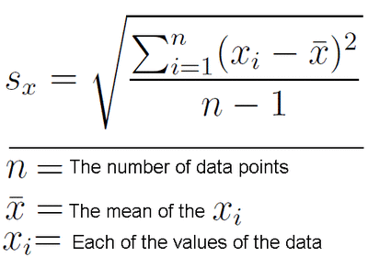
MEASURE OF DISPERSION
It refers to how the data deviates from the position measure i.e. gives an indication of the amount of variation in the process.
Dispersion of the data set can be described by:
Range: It is the difference between highest and the lowest values.
Standard Deviation: It is the measurement of average distance between each quantity and mean i.e. how data is spread out from mean. Higher the standard deviation, more is the data spread from mean.

Slide 10
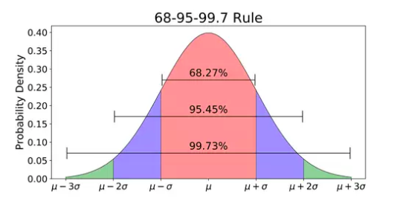
In normal distribution, when data is unimodal, z-scores is used to calculate the probability of a score occurring within a standard normal distribution and helps to compare two scores from different samples.
Below, calculating the probability of randomly obtaining a score from
the distribution.
68% probability for -1 and +1 standard deviation from mean.
Similarly, 95% for -1.96 and +1.96 standard deviation.

Slide 11
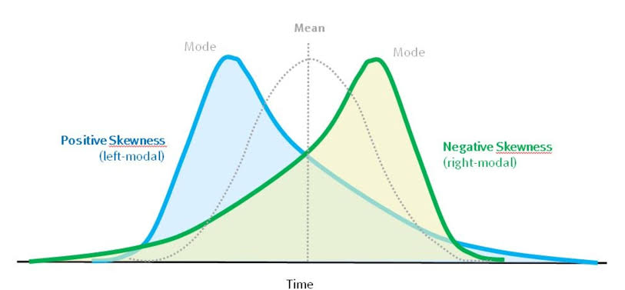
MEASURE OF SHAPE
It is used to characterize the location and variability of data set.
Two common statistics that measure the shape of the data are:
Skewness and Kurtosis
Skewness : It is the horizontal displacement of the normal curve about the mean position. Skewness for a normal distribution is zero.

Slide 12
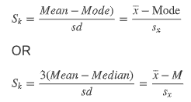

The methods to measure Skewness are:
Karl Pearson’s coefficient of Skewness: The value of coefficient is between -1 and +1.
Bowley’s coefficient of Skewness: It is based on quartile value.
Where,
Q1 = First quartile
Q2 = Second quartile
Q3= Third quartile

Slide 13

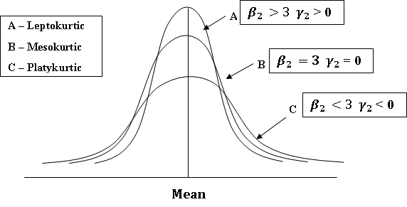
Moment Coefficient of Skewness: It is defined as
Where,
m3 = Skewness
m2 = Variance
Kurtosis: It is the vertical distortion of normal curve without disturbing symmetry of normal curve. The kurtosis for a standard normal distribution is three.

Slide 14
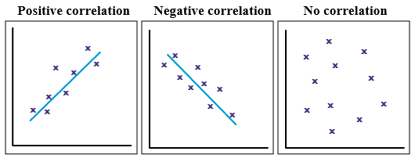
CORRELATION ANALYSIS
It is a statistical technique that can show whether and how strongly pairs of variables are related.
If correlation coefficient (r) is
Positive, then both variables are directly proportional.
Zero, there is no relation between them.
Negative, then both variables are inversely proportional

Slide 15
Correlation: On the basis of number of variables
Simple Correlation: It is when only two variables are analyzed.
For example, correlation between demand and supply.
Partial Correlation: It is when two or more variables are considered for analysis but only two influencing variables are studied, rest are constant. For example, correlation between demand, supply and income where income is constant.
Multiple Correlation: It is when three or more variables are analyzed simultaneously. For example, rainfall, production of rice and price of rice are studied simultaneously.

Slide 16
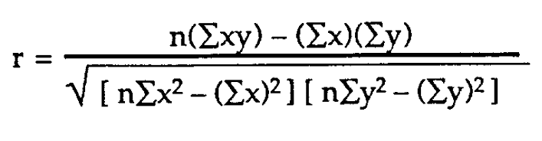
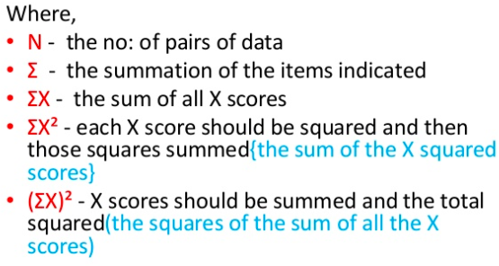
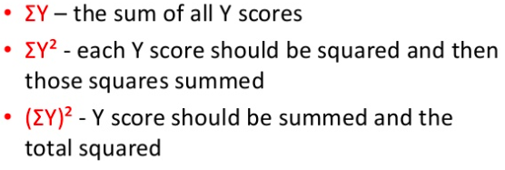
COMPUTATION OF COEFFICIENT OF CORRELATION
There are two methods for computation:
Pearson’s Product Moment Method:
Assumes, distribution to be normal.

Slide 17
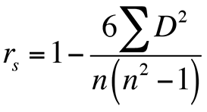
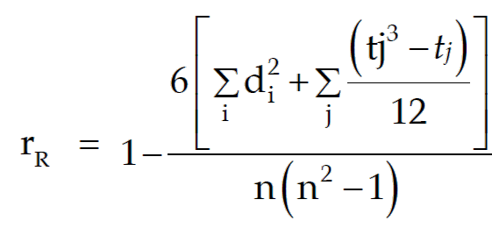
Spearmen Rank Moment Method
This method does not assume normal distribution.
For non-repeating ranks:
Where,
n = number of observations
D = difference between two ranks of each observation
For repeating ranks:
Where,
t = number of times a rank is repeated.

Slide 18
REGRESSION ANALYSIS
The statistical technique of estimating the unknown value of one variable(i.e. dependent variable) from the known value of other variable (i.e. independent variable) is called regression analysis.
Dependent Variable: The single variable which we wish to estimate/predict by regression model.
Independent Variable: The known variable(s) used to predict/estimate the value of dependent variable.
X is dependent, Y is independent
The regression equation of X on Y is:
X = a +bY
The regression equation of Y on X is:
Y = a +bX
Y is depedent, X is independent

Slide 19
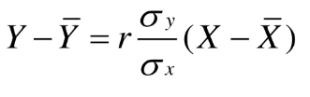



Regression Lines
The line which gives the best estimate of one variable for any given value of the other variable.
Y on X -
Where, regression coefficient of y on x :
X on Y -
Where, regression coefficient of y on x :
Where,
r = coefficient of correlation between x and y
𝛔 = standard deviation

Slide 20
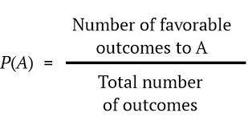


PROBABILITY
Probability is a numerical description of how likely an event is to occur or how likely it is that a proposition is true.
Some examples are:
Tossing a coin: When a coin is tossed, there are two possible outcomes: Heads (H) or Tails (T).Thus, probability of the coin landing H is ½ and the probability of the coin landing T is ½.
Rolling a die: When a single die is thrown, there are six possible outcomes: 1, 2, 3, 4, 5, 6.The probability of any one of them is 1/6.

Slide 21
TERMINOLOGY
Experiment: A process by which an outcome is obtained.
Sample space: The set S of all possible outcomes of an experiment. i.e. the sample space for a dice roll is {1, 2, 3, 4, 5, 6}
Event: Any subset E of the sample space i.e.
Let,
E₁ = An even number is rolled.
E₂ = A number less than three is rolled.
Outcome: Result of a single trial.
Equally likely outcomes: Two outcomes of a random experiment are said to be equally likely, if upon performing the experiment a (very) large number of times, the relative occurrences of the two outcomes turn out to be equal.
Trial: Performing a random experiment.

Slide 22

EVENTS
Simple Events : If the event E has only single element of a sample space, it is called as a simple event. Eg: if S = {56 , 78 , 96 , 54 , 89} and E = {78} then E is a simple event.
Compound Events: Any event consists of more than one element of the sample space. Eg: if S = {56 ,78 ,96 ,54 ,89}, E1 = {56 ,54 }, E2 = {78 ,56 ,89 } then, E1 and E2 represent two compound events.
Independent Events and Dependent Events:
If the occurrence of any event is completely unaffected by the occurrence of any other event, such events are Independent Events.
Probability of two independent event is given by,

Slide 23


The events which are affected by other events are Dependent Events.
Probability of dependent event is given by,
Exhaustive Events: A set of events is called exhaustive if all the events together consume the entire sample space. Eg: A and B are sets of mutually exclusive events,
Where,
S = sample space
Mutually Exclusive Events: If the occurrence of one event excludes the occurrence of another event i.e. no two events can occur simultaneously.

Slide 24
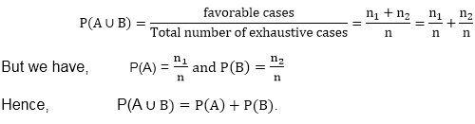
Addition Theorem
Theorem 1: If A and B are two mutually exclusive events, then
P(A ∪ B) = P(A) + P(B)
Where,
n = Total number of exhaustive cases n1= Number of cases favorable to A. n2= Number of cases favorable to B.
Theorem2: If A and B are two events that are not mutually exclusive, then P(A ∪ B) = P( A ) + P( B ) - P ( A ∩ B )
Where,
P (A ∩ B) = Probability of events favorable to both A and B

Slide 25

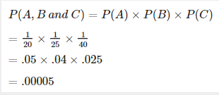
Multiplication Theorem
If A and B are two independent events, then the probability that both will occur is equal to the product of their individual probabilities.
Example:
The probability of appointing a lecturer who is B.Com, MBA, and PhD, with probabilities 1/20, 1/25 and 1/40 is given by:
Using multiplicative theorem for independent events,

Slide 26
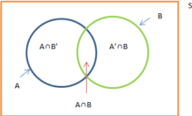
Conditional Probability
The conditional probability of an event B is the probability that the event will occur given the knowledge that an event A has already occurred. It is representated as P( B | A).
P(A | B) = P(A ∩ B) ⁄ P(B)
Where A and B are two dependent events.

Slide 27

Total Probability Theorem
Given n mutually exclusive events A1, A2, … Ak such that their probabilities sum is unity and their union is the event space E, then Ai ∩ Aj = NULL, for all i not equal to j
A1 U A2 U ... U Ak = E
Then Total Probability Theorem or Law of Total Probability is:
where B is an arbitrary event, and P(B/Ai) is the conditional probability of B assuming A already occurred.

Slide 28
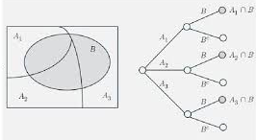
Proof of Total Probability Theorem :
We know,
A1 U A2 U A3 U ….. U AK = E(Total)
Then, for any event B, we have,
B = B ∩ E
B = B ∩ (A1 U A2 U A3 U … U AK)
As intersection and Union are Distributive. Therefore,
B = (B ∩ A1) U (B ∩ A2) U ….... U (B ∩ AK)
Since all these partitions are disjoint. So, we have,
P (B ∩ A1) = P (B ∩ A1) U P(B ∩ A2) U ….... U P (B ∩ AK)
This is, addition theorem of probabilities for union of disjoint events.
Using Conditional Probability:
P (B / A) = P(B ∩ A) / P(A)

Slide 29
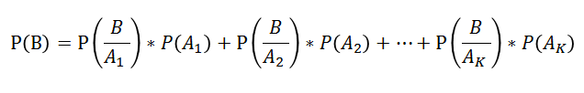
As the events are said to be independent here,
P(A ∩ B) = P(A) * P(B)
where P(B|A) is the conditional probability which gives the probability of occurrence of event B when event A has already occurred. Hence,
P( B ∩ Ai ) = P( B | Ai ).P( Ai ) ; i = 1,2,3 . . . k
Applying this rule above:
This is Law of Total Probability.
It is used for evaluation of denominator in Bayes’ Theorem.

Slide 30
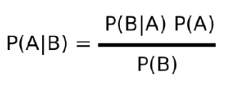
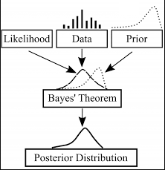
BAYES’ THEOREM
It is a mathematical formula for determining conditional probability.
In above formula, the posterior probability is equal to the conditional probability of event B given A multiplied by the prior probability of A, all divided by the prior probability of B.
Science itself is a special case of Bayes’ theorem because we are revising a prior probability( hypothesis) in the light of observation or experience that confirms our hypothesis( experimental evidence) to develop a posterior probability( conclusion)

Slide 31
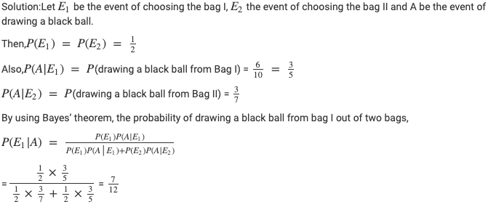
Example Bayes’ Theorem:

Slide 32







Probability Distribution

Slide 33
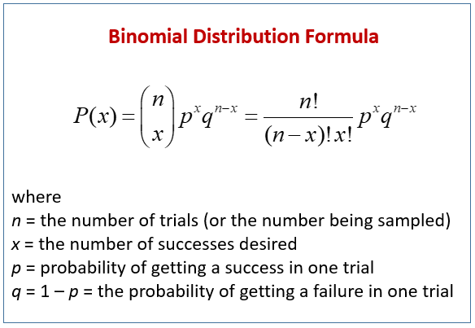
BINOMIAL DISTRIBUTION
OF PROBABILITY
A binomial distribution is the probability of a SUCCESS or FAILURE outcome in an experiment or survey that is repeated multiple times.
Criteria for binomial distribution:
The number of observations or trials is fixed
Each observation or trial is independent.
The probability of success (tails, heads, fail or pass) is exactly the same from one trial to another.

Slide 34
Example:
Q. A coin is tossed 10 times. What is the probability of getting exactly 6 heads?
The number of trials (n) is 10
x = 6
The odds of success (p) (tossing a heads) is 0.5
Odds of failure (q) = 1- p
P(x=6) = 10C6 * 0.5^6 * 0.5^4
= 210 * 0.015625 * 0.0625
= 0.205078125

Slide 35

POISSON DISTRIBUTION
OF PROBABILITY
When the number of trials in a binomial distribution is very large, and the probability of success is very small, then np ~ npq (as q ~ 1), therefore it is possible to change the distribution to a Poisson distribution.
The Poisson distribution is the discrete probability distribution of the number of events occurring in a given time period, given the average number of times the event occurs over that time period.
Where,
x = 0,1,2,3….
ƛ = mean number of occurrences in the interval
e = Euler’s constant

Slide 36
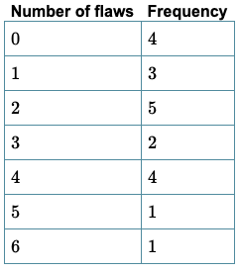
Example:
Q. Twenty sheets of aluminum alloy were examined for surface flaws. The frequency of the number of sheets with a given number of flaws per sheet was as follows
What is the probability of finding a sheet chosen at random which contains 3 or more surface flaws?
The total number of flaws = (0x4)+(1x3)+(2x5)+(3x2+(4x4)+(5x1)+(6x1) = 46
So the average for 20 sheets (ℳ ) = 46/20 = 2.3
Probability = P(X>=3)
= 1 – (P(x0) +P(x1)+P(x2))
Using Poisson distribution formula
= 0.40396

Slide 37
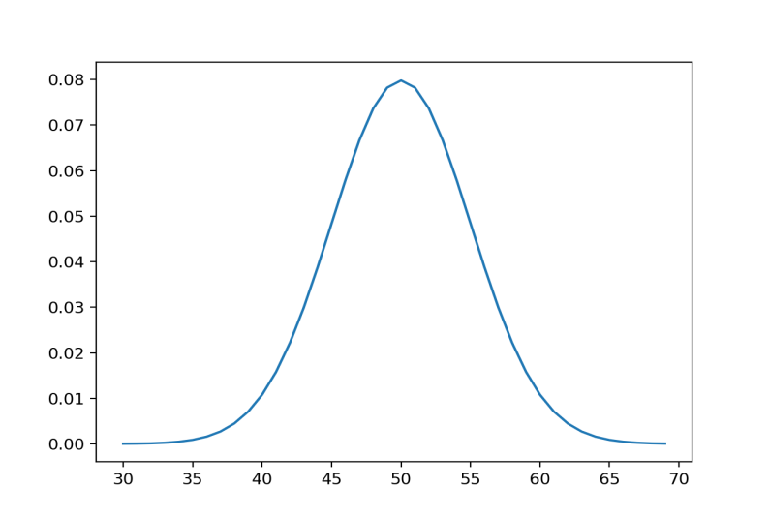
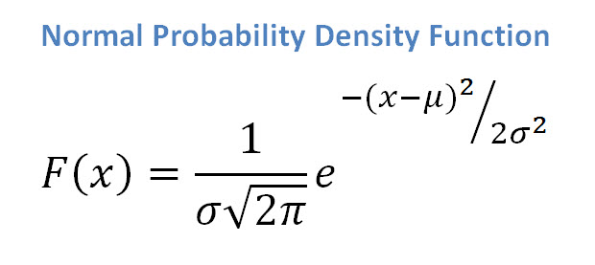
Continuous Distribution
A probability distribution in which the random variable X can take on any value (is continuous) i.e. the probability of X taking on any one specific value is zero.
Normal Distribution: A continuous random variable x is said to follow normal distribution, if its probability density function is define as follow,
Where, (μ)= means and (σ)= standard deviations.

Slide 38

Chi- Squared Test:
The Chi-Square statistic is commonly used for testing relationships between categorical variables.
The null hypothesis of the Chi-Square test is that no relationship exists on the categorical variables in the population. They are independent. The calculation of the Chi-Square statistic is quite straight-forward and intuitive.
Where,
f_{o} = The observed frequency ,
f_{e} = The expected frequency if NO relationship existed
between the variables,
χ² = Degree of freedom.

Slide 39
THANK YOU 🤘

